Slide 1
Mini Project
Name | Chaithanya Sachidananda Manthana H K Ananya V Bhatt
Registration Numbers | 231058005 | 231058012 | 231058029
Branch | Big Data Analytics
Project Title | Support Vector Machine based Fault Classification in Batch Reactor Process
Guide | Dr. Arockiaraj S

Slide 2
Presentation Outline
Introduction
Problem Statement
Objectives
Literature Review
Methodology
Dataset
Conclusion and Future Work
References

Slide 3
1. Introduction
Batch reactor processes are a common and versatile method in chemical and pharmaceutical industries for producing a wide range of products.
Fault detection and diagnosis (FDD) in process industries is an important task for efficient process monitoring and plant safety.
A fault diagnosis approach based on multi-kernel support vector machines is proposed to classify the faults.

Slide 4
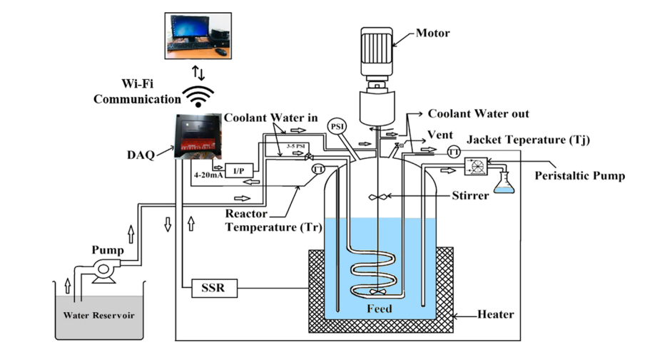
2. Problem Statement
This project aims to develop a Multi Kernel Non linear Support Vector Machine (SVM)-based machine learning model for fault classification in a Batch Reactor Process, by using historical process data and sensor readings , the model will classify and detect various faults in Batch reactor process. Evaluation will focus on accuracy, precision, recall, and F1-score, with an emphasis on reducing false negatives and conveying it to batch reactor monitoring system.

Slide 5
2. Objectives
Objectives of the work
Collection of dataset from Batch Reactor process, which includes major attributes like actuator data, temperature of the coolant, temperature of the reactor and temperature jacket (outcome).
Fault diagnosis model is built using MK-SVM algorithm.
Model has to detect the fault (temperature attributes) introduced in the Batch Reactor process.
Upon detecting these faults, the model will generate visual plots that clearly depict the temperature variations and anomalies, allowing for easy identification and analysis.

Slide 6
3. Literature Review
Authors and Title | Methodology | Outcome
Fault Diagnosis of Batch Reactor Using Machine Learning Methods
Sujatha Subramanian,Fathima Ghouse,Pappa Natarajan
Model based fault detection method is developed based on replica of the real plant dynamics. The different faults have been introduced in the reactor through simulation From the simulated input and output data, SVM estimator model is developed using LIBSVM toolbox.
In this paper, SVM model is used to generate the residual faults in noises present in image. Fault classification has been done from the based labelling errors into different classes.
Multiple Fault Diagnosis in Distillation Column Using
Multikernel Support Vector Machine
Syed A. Taqvi, Lemma Dendena, Haslinda Zabiri, Abdulhalim Shah Maulud
The main contribution of this work is as follows:
1.A fault diagnosis method for the distillation column is proposed on the basis of machine learning techniques.
2. A multiple kernel support vector machine is constructed for the recognition of normal and fault classes to classify the novel faults in the distillation column.
In this work, the application of SVM is presented for fault diagnosis in the distillation column. For the specific type of faults SVM has better classification accuracy.
Big data approach to batch process monitoring: Simultaneous fault detection and diagnosis using nonlinear support vector machine-based feature selection
Melis, Chris A, Yannis A
The proposed method consists of two phases: (i) Offline phase includes the formulation of the fault and time-specific models for fault detection (ii) Online phase monitors ongoing batches in real-time by using the fault and time-specific models.
In this paper it enabled early intervention to the process to reverse the detected fault, reduce the number of sensor measurements to diagnose the detected fault, guide the optimal sensor placement.

Slide 7
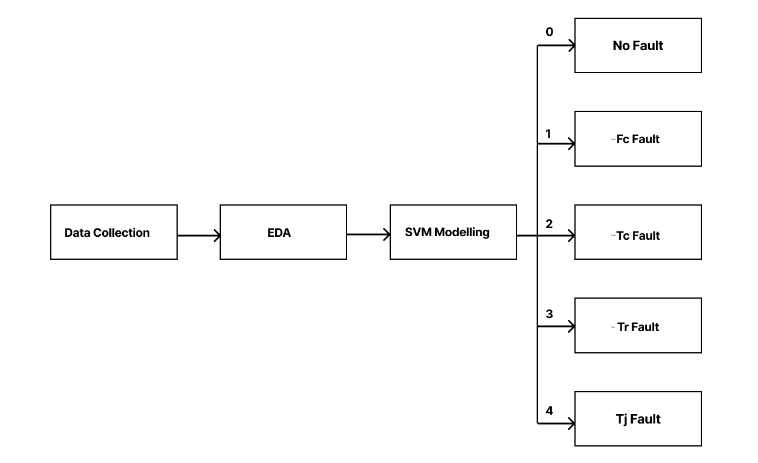
4. Methodology
Block Diagram of the System

Slide 8
4. Methodology
Support Vector Machine
A Support Vector Machine (SVM) is a powerful and versatile machine learning algorithm used for classification and regression tasks.
Binary Classification:
SVM is primarily used for binary classification problems, where the goal is to separate data points into one of two classes.
Hyperplane:
At the core of SVM is the concept of a hyperplane, which is a multidimensional surface that separates data points from different classes.
Margin:
SVM aims to find the hyperplane that maximizes the margin, which is the
distance between the hyperplane and the nearest data points from each class.

Slide 9
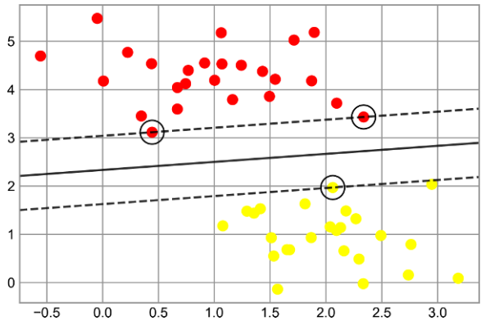
4. Methodology
C Parameter:
SVM has a regularization parameter known as "C." It controls the trade-off between the maximizing the margin and minimizing the classification error.
Support Vectors:
Support vectors are the data points closest to the hyperplane and are the ones that have the most influence on the placement of the hyperplane.
A support vector machine classifier fit to the data, with margins (dashed lines) and support vectors (circles) shown

Slide 10
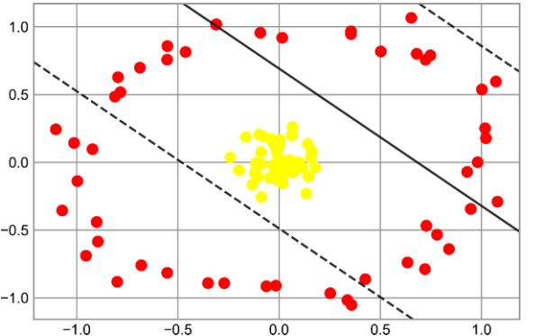
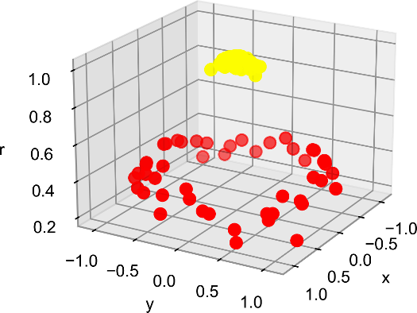
4. Methodology
Kernel Trick:
SVM can be used for non-linear data by employing the kernel trick. Common kernel functions include the linear kernel, polynomial kernel, and radial basis function (RBF) kernel.
Kernelization transformation in Support Vector Machines (SVMs) is a technique used to extend SVMs to handle non-linearly separable data.
A linear classifier performs poorly for nonlinear boundaries
A third dimension added to the data allows for linear separation

Slide 11


4. Methodology
Weight Calculation for Two Class SVM
In Support Vector Machines (SVMs), the weights, denoted as w, are an important part of the model.
The decision boundary is the locus of points where the inner product of the feature vector x and w plus a bias term b equals zero:
w * x + b = 0
Vectors that have positive f(x) are placed in one class, while vectors that have negative f(x) are placed in another class.
Maximum margin can be obtained by solving the minimization problem given by

Slide 12


4. Methodology
Weight Calculation for Multi-kernel SVM
The constrained optimization problem can be solved by using a Lagrange multiplier λi, where λi ≥ 0. This corresponds to the constraint, for a support vector. The solution can be written as minimize
The optimization problem in above equation can be defined as minimize

Slide 13
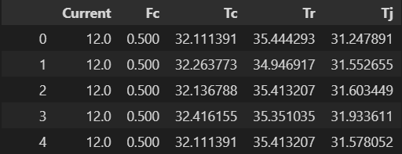
5. Dataset
The dataset contains informations from all sensors used in the experimental setup
In which we are using only data which help in performing fault classification
feature which usened are:
Current
Fc
Tc
Tr
Tj
Using this data we are introducing introducing error in interval of time in data showing fault
Based on which new labelling feature called Error specifying where error is present been put where errors are present

Slide 14
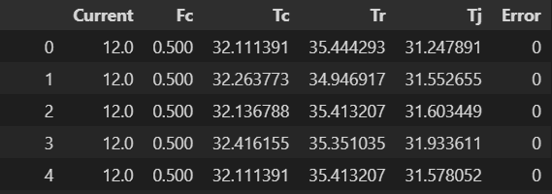
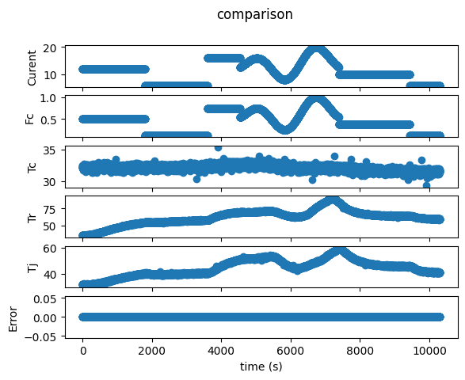
5. Dataset
We have manually simulated and introduced error in certain interval of time to generate faulty data needed for fault classification.
When there is no error present in sensor the ‘Error’ will be 0 as seen in data snapshot and visual representation of data when no error are present.

Slide 15
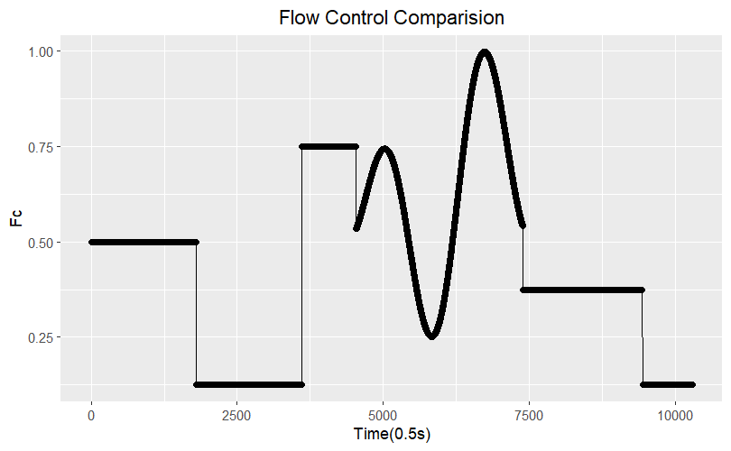
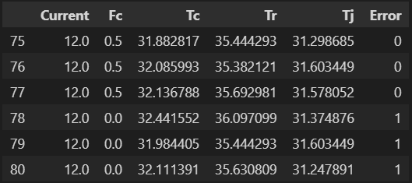
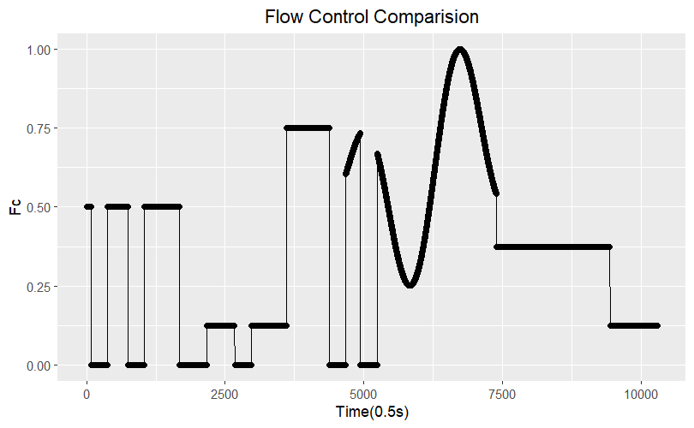
5. Dataset
When we introduced error in
Fc Error

Slide 16
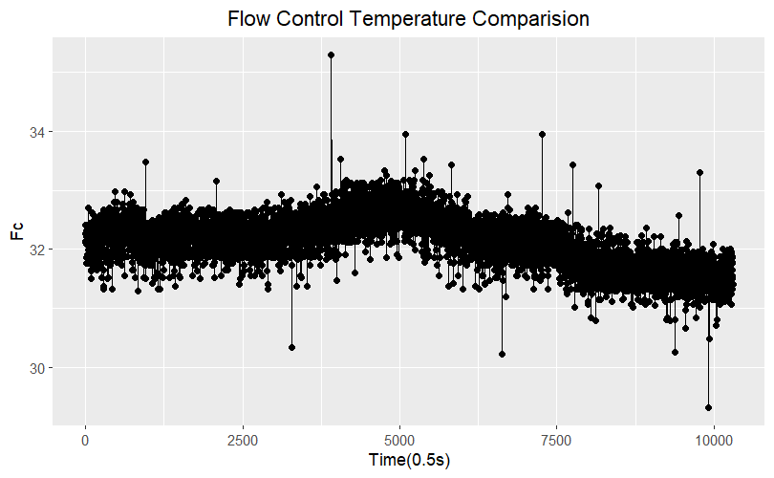
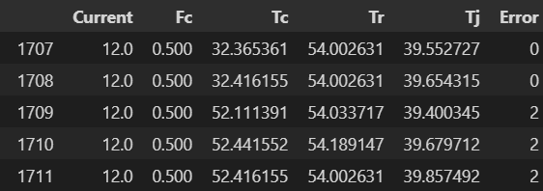
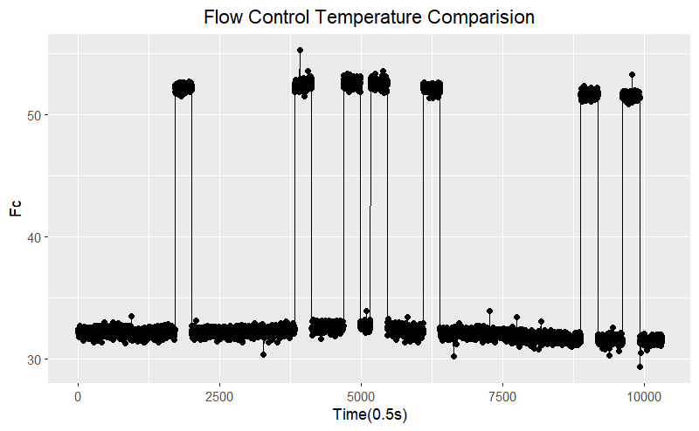
5. Dataset
When we introduced error in
2. Tc Error

Slide 17
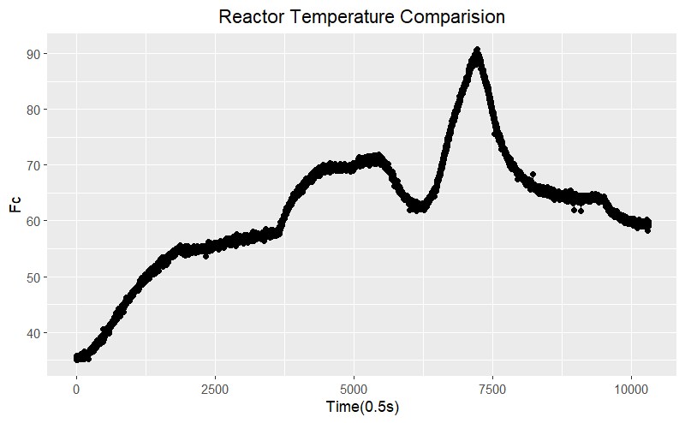
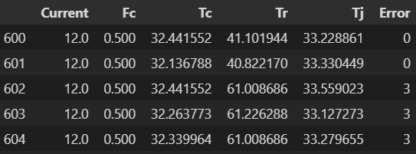
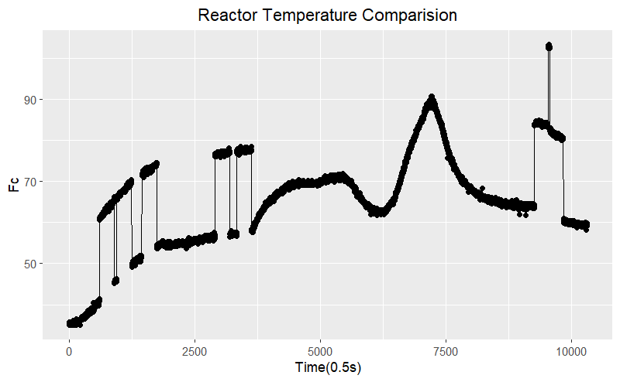
5. Dataset
When we introduced error in
3. Tr Error

Slide 18
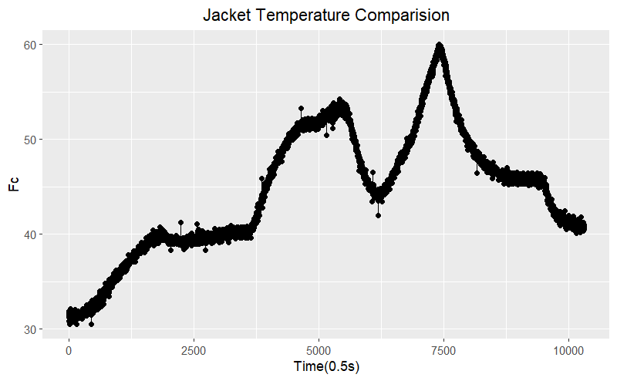
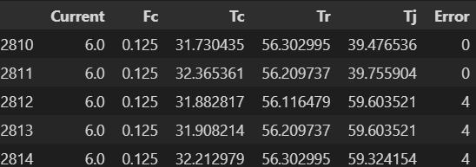
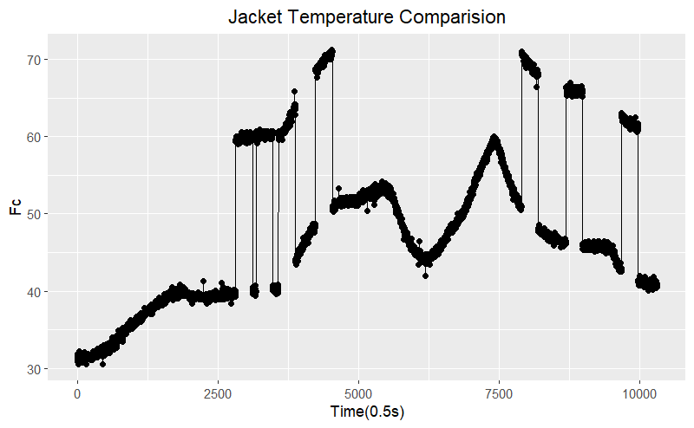
5. Dataset
When we introduced error in
4. Tj Error

Slide 19
6. Result and Conclusion
We confirmed and verified that for the batch reactor process fault classification best suited Machine Learning algorithm is SVM Classifier(Support Vector Machines classification).
Weight parameter required for this model we have inferred from our data that multiclass and Nonlinear Kernel is well suited for this Project.
The feature which we have been provide for us in data is best suited features for classification of fault.
Random generation of fault in data has been achieved in time scale interval points with labelling of the error in the predictive features.

Slide 20
7. Future Scope and Improvement
Trial and error method of finding the best non linear kernel is yet to be tested on the faulty data.
The optimal weights which have been calculated on paper are yet to be tested on the real time model of SVM
Since the data is of Time Series format we yet to test the deep learning model and verify if our data perform better in them.
Verification of finding new other better means on generating random faulty data is to be confirmed once again

Slide 21
References
[1] Nor, N. M.; Hussain, M. A.; Hassan, C. R. C. Fault diagnosis and
classification framework using multi-scale classification based on kernel
Fisher discriminant analysis for chemical process system. Applied Soft
Computing 2017, 61, 959−972.
[2] Uddin, F.; Tufa, L. D.; Taqvi, S. A. System Behavior and
Predictive Controller Performance near Azeotropic Region. Chem. Eng.
Technol. 2018, 806−818.
[3] Taqvi, S. A.; Tufa, L. D.; Muhadizir, S. Optimization and
dynamics of distillation column using Aspen Plus®. Procedia Eng. 2016,
148, 978−984.
[4] Taqvi, S. A.; Tufa, L. D.; Zabiri, H.; Mahadzir, S.; Maulud, A. S.;
Uddin, F. Rigorous dynamic modelling and identification of distillation
column using Aspen Plus; 8th Control and System Graduate Research
Colloquium (ICSGRC); IEEE: 2017; pp 262−267.

Slide 22
Queries
&
Suggestions

Slide 23
THANK YOU…

